Slide 1
Software Testing

Slide 2
Program testing
Testing:
Showing what a program is doing.
Detecting anomalies in the system.
Generally, software testing uses sample data
Custom software: at least 1 test for every requirement.
Generic Software: tests for every feature present in product release
Testing is concerned with rooting out undesirable system behavior such as system crashes, unwanted interactions with other systems, incorrect computations, and data corruption.

Slide 3
Program testing
Testing can be done manually or automatically (via automated test cases, e.g., Junit in Java).
Testing is a broader part of Software verification & validation
Are we building the right product? (validation)
Are we building the product right? (verification) ~ checking for functional and non-functional testing
Broadly, testing can be classified as black-box testing / white box testing.
Black box testing: testing system without checking inner details
Whitebox testing: testing each component separately.

Slide 4
Program testing
Testing could be done to check the functional or nonfunctional requirements both named functional testing & non-functional testing, respectively.
Functional testing: checking for each functionality in the code
Non-functional testing: checking for performance, scalability, system recovery, etc.

Slide 5
Validation and defect testing
Testing goals:
Confirms to developer and customers that system is up to user requirements
Find bugs or anomalies in the system.
The first goal leads to validation testing
The second goal leads to defect testing

Slide 6
Testing process goals
Validation testing
To demonstrate to the developer and the system customer that the software meets its requirements
A successful test shows that the system operates as intended.
Defect testing
To discover faults or defects in the software where its behavior is incorrect or not in conformance with its specification
A successful test is a test that makes the system perform incorrectly and so exposes a defect in the system.
No hard boundary is defined between these two testing techniques.

Slide 7
An input-output model of program testing validation & defect both

Slide 8
V & V confidence
Aim of V & V is to claim that the system is ‘fit for purpose.
Depends on:
Software purpose
The criticality of the software to the stakeholders.
e.g., file alarm system vs an LMS
User expectations
Users may have low expectations for newly installed systems but they expect them to be reliable depending upon the software deployment age.
Marketing environment
Getting a product to market early may be more important than finding defects in the program.

Slide 9
Inspections and testing
Software inspections
Concerned with analysis of the static system representation to discover problems (static verification)
May be supplemented by tool-based document and code analysis.
Software testing
Concerned with exercising and observing product behaviour (dynamic verification)
The system is executed with test data and its operational behaviour is observed.

Slide 10
Software inspections
Inspections:
people examining the representations with the aim of discovering anomalies and defects.
Inspections do not require execution of a system so may be used before implementation. (static V& V technique)
Can be applied to any representation of the system (requirements, design, configuration data, test data, etc.).
They have been shown to be an effective technique for discovering program errors.

Slide 11
Inspections and testing

Slide 12
Advantages of inspections
During testing, errors can mask (hide) other errors. In case of any error occurrence, we cannot predict that the anomalies occurring after first error is because of previous one or the new errors. Because inspection is a static process, you don’t have to be concerned with interactions between errors.
Incomplete versions of a system can be inspected without additional costs. If a program is incomplete, then you need to develop specialized test harnesses to test the parts that are available.

Slide 13
Advantages of inspections
An inspection can also ensure the compliance with standards, portability and maintainability. You can check for inefficient codes, poor programming styles that could make system maintenance difficult.
Inspections are more effective for defect discovery than testing.
Problems in inspection:
Can’t check defects that arise because of unexpected interaction between systems.

Slide 14
Inspections and testing
Inspections and testing are complementary and not opposing verification techniques.
Both should be used during the V & V process.
Inspections cannot check non-functional characteristics such as performance, usability, etc. as its static.

Slide 15
A model of the software testing process

Slide 16
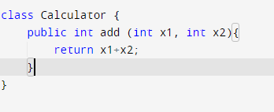
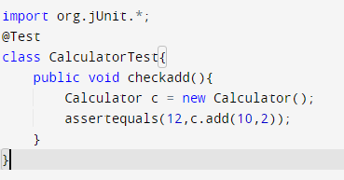

Slide 17
Stages of testing
Development testing:
where the system is tested during development to discover bugs and defects.
Done by developers
Release testing:
where a separate testing team tests a complete version of the system before it is released to users.
Done by QAs
User testing:
where users or potential users of a system test the system in their own environment.

